Slide 1
Chinese Remainder Theorem: What we can and can’t do
INSERT
VIDEO
HERE

Slide 2
Chinese Remainder Theorem: What we can and can’t do
N=60
INSERT
VIDEO
HERE

Slide 3
Chinese Remainder Theorem: What we can and can’t do
N=60
CRT moduli = (3, 4, 5)
INSERT
VIDEO
HERE

Slide 4
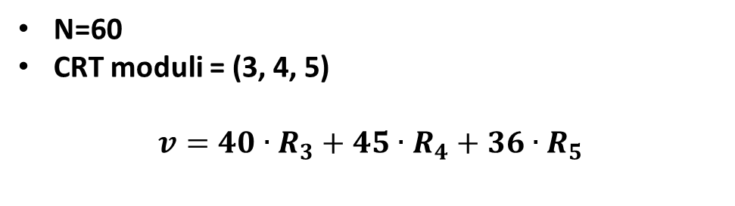
Chinese Remainder Theorem: What we can and can’t do
N=60
CRT moduli = (3, 4, 5)
$$v=40∙R_{3}+45∙R_{4}+36∙R_{5}$$
INSERT
VIDEO
HERE

Slide 5
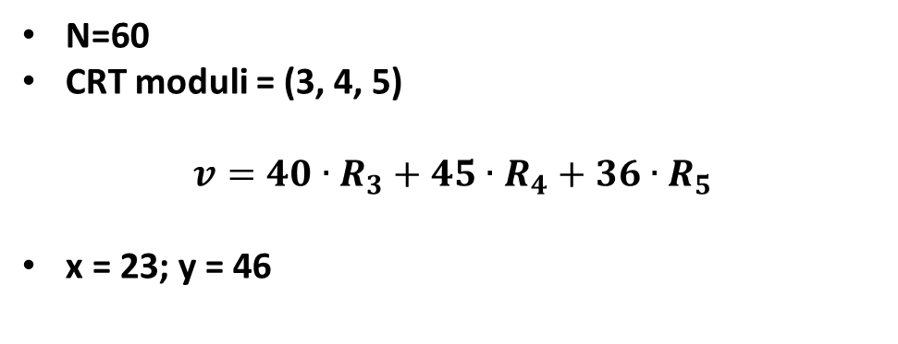
Chinese Remainder Theorem: What we can and can’t do
N=60
CRT moduli = (3, 4, 5)
$$v=40∙R_{3}+45∙R_{4}+36∙R_{5}$$
x = 23; y = 46
INSERT
VIDEO
HERE

Slide 6
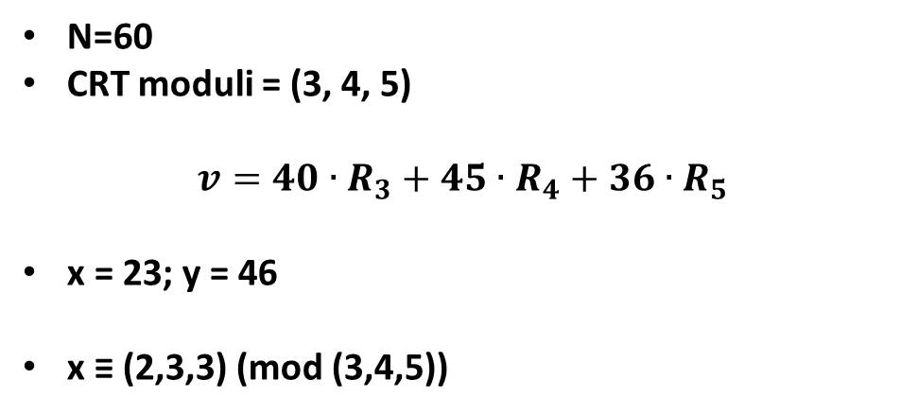
Chinese Remainder Theorem: What we can and can’t do
N=60
CRT moduli = (3, 4, 5)
$$v=40∙R_{3}+45∙R_{4}+36∙R_{5}$$
x = 23; y = 46
x ≡ (2,3,3) (mod (3,4,5))
INSERT
VIDEO
HERE

Slide 7
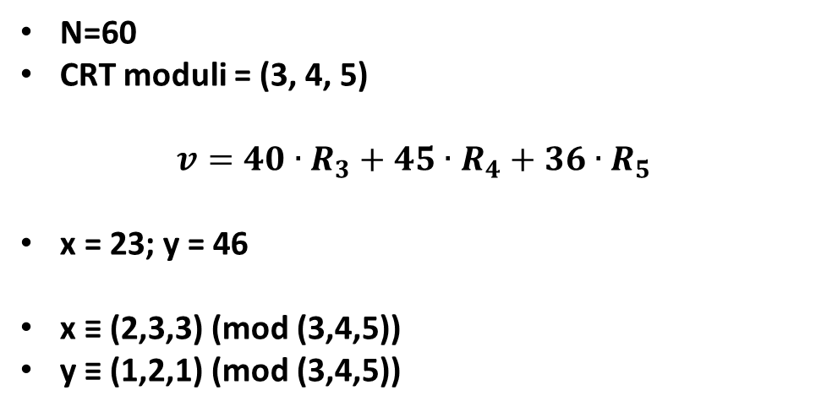
Chinese Remainder Theorem: What we can and can’t do
N=60
CRT moduli = (3, 4, 5)
$$v=40∙R_{3}+45∙R_{4}+36∙R_{5}$$
x = 23; y = 46
x ≡ (2,3,3) (mod (3,4,5))
y ≡ (1,2,1) (mod (3,4,5))
INSERT
VIDEO
HERE

Slide 8
Only two numbers, 0 and 1, have the same representation in all CRT worlds
INSERT
VIDEO
HERE

Slide 9
Only two numbers, 0 and 1, have the same representation in all CRT worlds
0 ≡ (0,0,…,0) (mod anything)
INSERT
VIDEO
HERE

Slide 10
Only two numbers, 0 and 1, have the same representation in all CRT worlds
0 ≡ (0,0,…,0) (mod anything)
1 ≡ (1,1,…,1) (mod anything)
INSERT
VIDEO
HERE

Slide 11
Only two numbers, 0 and 1, have the same representation in all CRT worlds
0 ≡ (0,0,…,0) (mod anything)
1 ≡ (1,1,…,1) (mod anything)
Any other value depends on moduli chosen
INSERT
VIDEO
HERE

Slide 12
CRT Addition: Add the respective residues
INSERT
VIDEO
HERE

Slide 13
CRT Addition: Add the respective residues
z = x + y
INSERT
VIDEO
HERE

Slide 14
CRT Addition: Add the respective residues
z = x + y
z₃ = (x + y) mod 3
INSERT
VIDEO
HERE

Slide 15
CRT Addition: Add the respective residues
z = x + y
z₃ = (x + y) mod 3
z₃ = ( (x mod 3) + (y mod 3) ) mod 3
INSERT
VIDEO
HERE

Slide 16
CRT Addition: Add the respective residues
z = x + y
z₃ = (x + y) mod 3
z₃ = ( (x mod 3) + (y mod 3) ) mod 3
z₃ = ( x₃ + y₃ ) mod 3
INSERT
VIDEO
HERE

Slide 17
CRT Addition: Add the respective residues
z = x + y
z₃ = (x + y) mod 3
z₃ = ( (x mod 3) + (y mod 3) ) mod 3
z₃ = ( x₃ + y₃ ) mod 3
z₃ ≡ x₃ + y₃
INSERT
VIDEO
HERE

Slide 18
CRT Addition: Add the respective residues
z = x + y
z₃ = (x + y) mod 3
z₃ = ( (x mod 3) + (y mod 3) ) mod 3
z₃ = ( x₃ + y₃ ) mod 3
z₃ ≡ x₃ + y₃
23 + 46 ≡ 69 ≡ 9 ≡ (0,1,4) (mod 60)
INSERT
VIDEO
HERE

Slide 19
CRT Addition: Add the respective residues
z = x + y
z₃ = (x + y) mod 3
z₃ = ( (x mod 3) + (y mod 3) ) mod 3
z₃ = ( x₃ + y₃ ) mod 3
z₃ ≡ x₃ + y₃
23 + 46 ≡ 69 ≡ 9 ≡ (0,1,4) (mod 60)
(2,3,3) + (1,2,1) ≡ (3,5,4) ≡ (0,1,4) (mod 60)
INSERT
VIDEO
HERE

Slide 20
CRT Multiplication: Multiplying by an integer is trivial
INSERT
VIDEO
HERE

Slide 21
CRT Multiplication: Multiplying by an integer is trivial
k·x ≡ k(40·x₃ + 45·x₄ + 36·x₅) (mod 60)
INSERT
VIDEO
HERE

Slide 22
CRT Multiplication: Multiplying by an integer is trivial
k·x ≡ k(40·x₃ + 45·x₄ + 36·x₅) (mod 60)
k·x ≡ (40·(k·x₃) + 45·(k·x₄) + 36·(k·x₅)) (mod 60)
INSERT
VIDEO
HERE

Slide 23
CRT Multiplication: Multiplying by an integer is trivial
k·x ≡ k(40·x₃ + 45·x₄ + 36·x₅) (mod 60)
k·x ≡ (40·(k·x₃) + 45·(k·x₄) + 36·(k·x₅)) (mod 60)
k·x ≡ (k·x₃, k·x₄, k·x₅) (mod 60)
INSERT
VIDEO
HERE

Slide 24
CRT Multiplication: Multiplying by an integer is trivial
k·x ≡ k(40·x₃ + 45·x₄ + 36·x₅) (mod 60)
k·x ≡ (40·(k·x₃) + 45·(k·x₄) + 36·(k·x₅)) (mod 60)
k·x ≡ (k·x₃, k·x₄, k·x₅) (mod 60)
2·(2,3,3) ≡ (4,6,6) ≡ (1,2,1) (mod 60)
INSERT
VIDEO
HERE

Slide 25
CRT Multiplication: Multiply the respective residues
INSERT
VIDEO
HERE

Slide 26
CRT Multiplication: Multiply the respective residues
z ≡ (40·x₃+45·x₄+36·x₅)(40·y₃+45·y₄+36·y₅) (mod 60)
INSERT
VIDEO
HERE

Slide 27
CRT Multiplication: Multiply the respective residues
z ≡ (40·x₃+45·x₄+36·x₅)(40·y₃+45·y₄+36·y₅) (mod 60)
z₃ ≡ (40·x₃)·(40·y₃) (mod 3) (mod 3)
INSERT
VIDEO
HERE

Slide 28
CRT Multiplication: Multiply the respective residues
z ≡ (40·x₃+45·x₄+36·x₅)(40·y₃+45·y₄+36·y₅) (mod 60)
z₃ ≡ (40·x₃)·(40·y₃) (mod 3) (mod 3)
z₃ ≡ (1·x₃)(1·y₃) (mod 3)
INSERT
VIDEO
HERE

Slide 29
CRT Multiplication: Multiply the respective residues
z ≡ (40·x₃+45·x₄+36·x₅)(40·y₃+45·y₄+36·y₅) (mod 60)
z₃ ≡ (40·x₃)·(40·y₃) (mod 3) (mod 3)
z₃ ≡ (1·x₃)(1·y₃) (mod 3)
z₃ ≡ x₃·y₃ (mod 3)
INSERT
VIDEO
HERE

Slide 30
CRT Multiplication: Multiply the respective residues
z ≡ (40·x₃+45·x₄+36·x₅)(40·y₃+45·y₄+36·y₅) (mod 60)
z₃ ≡ (40·x₃)·(40·y₃) (mod 3) (mod 3)
z₃ ≡ (1·x₃)(1·y₃) (mod 3)
z₃ ≡ x₃·y₃ (mod 3)
23·46 ≡ 1058 ≡ 38 ≡ (2,2,3) (mod 60)
INSERT
VIDEO
HERE

Slide 31
CRT Multiplication: Multiply the respective residues
z ≡ (40·x₃+45·x₄+36·x₅)(40·y₃+45·y₄+36·y₅) (mod 60)
z₃ ≡ (40·x₃)·(40·y₃) (mod 3) (mod 3)
z₃ ≡ (1·x₃)(1·y₃) (mod 3)
z₃ ≡ x₃·y₃ (mod 3)
23·46 ≡ 1058 ≡ 38 ≡ (2,2,3) (mod 60)
(2,3,3)·(1,2,1) ≡ (2,6,3) ≡ (2,2,3) (mod 60)
INSERT
VIDEO
HERE

Slide 32
CRT Multiplicative Inverse: Take the multiplicative inverse of the respective residues
INSERT
VIDEO
HERE

Slide 33
CRT Multiplicative Inverse: Take the multiplicative inverse of the respective residues
x⁻¹ ·x ≡ (1,1,1) (mod 60)
INSERT
VIDEO
HERE

Slide 34
CRT Multiplicative Inverse: Take the multiplicative inverse of the respective residues
x⁻¹ ·x ≡ (1,1,1) (mod 60)
(x⁻¹ ₃ · x₃, x⁻¹ ₄ · x₄, x⁻¹ ₅ · x₅) ≡ (1,1,1) (mod 60)
INSERT
VIDEO
HERE

Slide 35
CRT Multiplicative Inverse: Take the multiplicative inverse of the respective residues
x⁻¹ ·x ≡ (1,1,1) (mod 60)
(x⁻¹ ₃ · x₃, x⁻¹ ₄ · x₄, x⁻¹ ₅ · x₅) ≡ (1,1,1) (mod 60)
23⁻¹ ≡ (2,3,3)⁻¹ ≡ (2⁻¹,3⁻¹,3⁻¹) (mod 60)
INSERT
VIDEO
HERE

Slide 36
CRT Multiplicative Inverse: Take the multiplicative inverse of the respective residues
x⁻¹ ·x ≡ (1,1,1) (mod 60)
(x⁻¹ ₃ · x₃, x⁻¹ ₄ · x₄, x⁻¹ ₅ · x₅) ≡ (1,1,1) (mod 60)
23⁻¹ ≡ (2,3,3)⁻¹ ≡ (2⁻¹,3⁻¹,3⁻¹) (mod 60)
(2,3,3)⁻¹ ≡ (2,3,2) (mod 60) ≡ 47
INSERT
VIDEO
HERE

Slide 37
CRT Multiplicative Inverse: Take the multiplicative inverse of the respective residues
x⁻¹ ·x ≡ (1,1,1) (mod 60)
(x⁻¹ ₃ · x₃, x⁻¹ ₄ · x₄, x⁻¹ ₅ · x₅) ≡ (1,1,1) (mod 60)
23⁻¹ ≡ (2,3,3)⁻¹ ≡ (2⁻¹,3⁻¹,3⁻¹) (mod 60)
(2,3,3)⁻¹ ≡ (2,3,2) (mod 60) ≡ 47
(2,3,3)·(2,3,2) ≡ (1,1,1) (mod 60)
INSERT
VIDEO
HERE

Slide 38
CRT Multiplicative Inverse: Take the multiplicative inverse of the respective residues
x⁻¹ ·x ≡ (1,1,1) (mod 60)
(x⁻¹ ₃ · x₃, x⁻¹ ₄ · x₄, x⁻¹ ₅ · x₅) ≡ (1,1,1) (mod 60)
23⁻¹ ≡ (2,3,3)⁻¹ ≡ (2⁻¹,3⁻¹,3⁻¹) (mod 60)
(2,3,3)⁻¹ ≡ (2,3,2) (mod 60) ≡ 47
(2,3,3)·(2,3,2) ≡ (1,1,1) (mod 60)
23·47 ≡ 1081 ≡ 1 (mod 60)
INSERT
VIDEO
HERE

Slide 39
CRT Exponentiation: Distribute integer exponents across the residues
INSERT
VIDEO
HERE

Slide 40
CRT Exponentiation: Distribute integer exponents across the residues
x^{n} ≡ (x₃, x₄, x₅)^{n} (mod 60)
INSERT
VIDEO
HERE

Slide 41
CRT Exponentiation: Distribute integer exponents across the residues
x^{n} ≡ (x₃, x₄, x₅)^{n} (mod 60)
x^{n} ≡ (x₃^{n}, x₄^{n}, x₅^{n}) (mod 60)
INSERT
VIDEO
HERE

Slide 42
CRT Exponentiation: Distribute integer exponents across the residues
x^{n} ≡ (x₃, x₄, x₅)^{n} (mod 60)
x^{n} ≡ (x₃^{n}, x₄^{n}, x₅^{n}) (mod 60)
23³ ≡ (2³,3³,3³) (mod 60)
INSERT
VIDEO
HERE

Slide 43
CRT Exponentiation: Distribute integer exponents across the residues
x^{n} ≡ (x₃, x₄, x₅)^{n} (mod 60)
x^{n} ≡ (x₃^{n}, x₄^{n}, x₅^{n}) (mod 60)
23³ ≡ (2³,3³,3³) (mod 60)
23³ ≡ (8, 27, 27) ≡ (2, 3, 2) ≡ 47 (mod 60)
INSERT
VIDEO
HERE

Slide 44
CRT Exponentiation: Distribute integer exponents across the residues
x^{n} ≡ (x₃, x₄, x₅)^{n} (mod 60)
x^{n} ≡ (x₃^{n}, x₄^{n}, x₅^{n}) (mod 60)
23³ ≡ (2³,3³,3³) (mod 60)
23³ ≡ (8, 27, 27) ≡ (2, 3, 2) ≡ 47 (mod 60)
23³ ≡ 12167 ≡ 47 (mod 60)
INSERT
VIDEO
HERE

Slide 45
CRT Exponentiation: If the exponent is in CRT format, it's a real challenge
INSERT
VIDEO
HERE

Slide 46
CRT Exponentiation: If the exponent is in CRT format, it's a real challenge
2^{x} ≡ 2^{(x3, x4, x5) (mod60)} (mod 60)
INSERT
VIDEO
HERE

Slide 47
CRT Exponentiation: If the exponent is in CRT format, it's a real challenge
2^{x} ≡ 2^{(x3, x4, x5) (mod60)} (mod 60)
20 ≡ 80 (mod 60)
INSERT
VIDEO
HERE

Slide 48
CRT Exponentiation: If the exponent is in CRT format, it's a real challenge
2^{x} ≡ 2^{(x3, x4, x5) (mod60)} (mod 60)
20 ≡ 80 (mod 60)
φ(60) = 16
INSERT
VIDEO
HERE

Slide 49
CRT Exponentiation: If the exponent is in CRT format, it's a real challenge
2^{x} ≡ 2^{(x3, x4, x5) (mod60)} (mod 60)
20 ≡ 80 (mod 60)
φ(60) = 16
20 ≡ 4 (mod φ(60) )
INSERT
VIDEO
HERE

Slide 50
CRT Exponentiation: If the exponent is in CRT format, it's a real challenge
2^{x} ≡ 2^{(x3, x4, x5) (mod60)} (mod 60)
20 ≡ 80 (mod 60)
φ(60) = 16
20 ≡ 4 (mod φ(60) )
80 ≡ 0 (mod φ(60) )
INSERT
VIDEO
HERE

Slide 51
CRT Exponentiation: If the exponent is in CRT format, it's a real challenge
2^{x} ≡ 2^{(x3, x4, x5) (mod60)} (mod 60)
20 ≡ 80 (mod 60)
φ(60) = 16
20 ≡ 4 (mod φ(60) )
80 ≡ 0 (mod φ(60) )
2^{x} ≡ 2^{(40·x3 + 45·x4 + 36·x5)} (mod 60)
INSERT
VIDEO
HERE

Slide 52
CRT Exponentiation: If the exponent is in CRT format, it's a real challenge
2^{x} ≡ 2^{(x3, x4, x5) (mod60)} (mod 60)
20 ≡ 80 (mod 60)
φ(60) = 16
20 ≡ 4 (mod φ(60) )
80 ≡ 0 (mod φ(60) )
2^{x} ≡ 2^{(40·x3 + 45·x4 + 36·x5)} (mod 60)
2^{x} ≡ (2^{40·x3})(2^{45·x4})(2^{36·x5}) (mod 60)
INSERT
VIDEO
HERE

